Slide 1
DATA SCIENCE ASSIGNMENT
DATA CLEANING, DATA VISUALIZATION and HYPOTHESIS TESTING
TEAM: STALLIONS ADI
Ashish, Ishar, Dhruv

Slide 2
THE DATASET
YouTube statistics for the US region.
19 Columns
12 Numerical Columns
Views, likes, dislikes, video id, category id, comments, subscribers, among others.
7 Categorical Columns
Channel title, tags, description, boolean attributes, among others.
Contains 4548 rows.
Contains uniformly distributed missing and wrong values.

Slide 3
DATA CLEANING
No columns have been dropped.
Missing values in numerical columns have been replaced by the mean value of the items in the column.
Missing values in categorical columns have been replaced with the data in the previous cell.
49 items with wrong data have been replaced with a unique id.

Slide 4
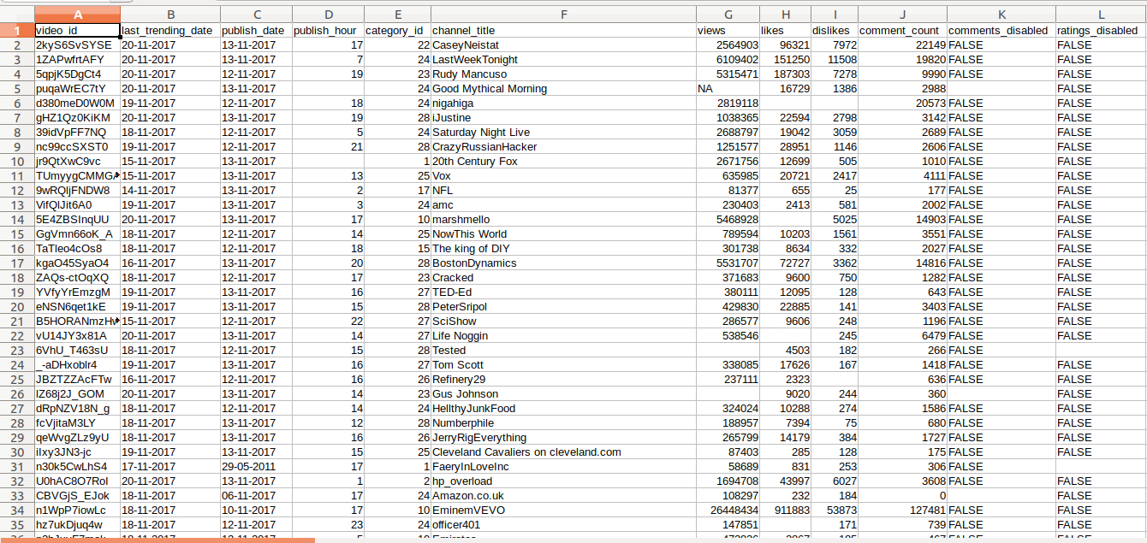

Slide 5
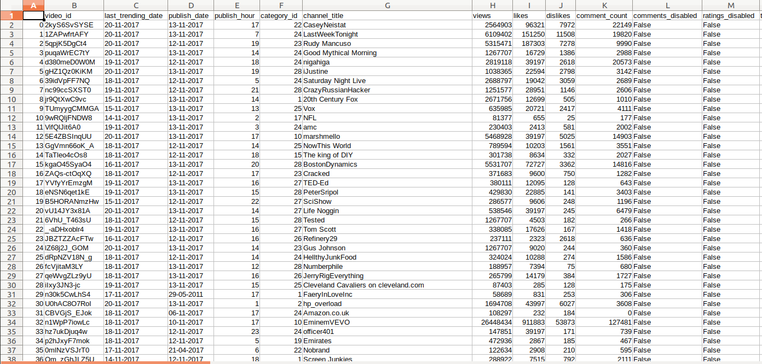

Slide 6
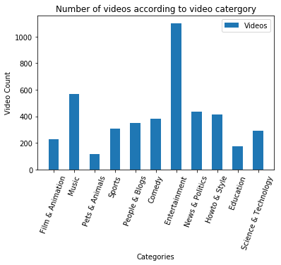
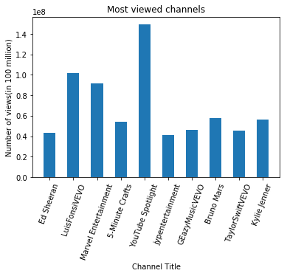
DATA VISUALIZATION
In bar graph 1, Entertainment has the most views, followed by music ,and news and politics.
From the second bar graph, YouTube Spotlight has the most views, followed by LuisFonsiVEVO, closely followed by Marvel Entertainment.

Slide 7
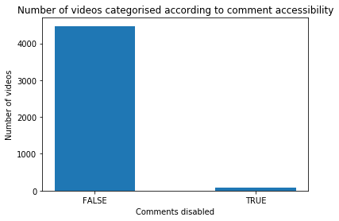
DATA VISUALIZATION
A large fraction of videos have comments enabled.

Slide 8
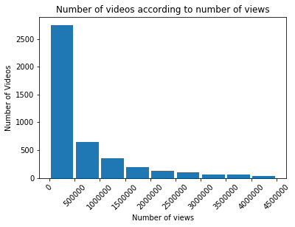
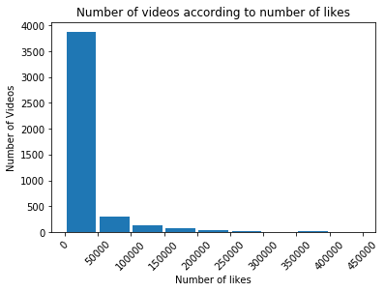
DATA VISUALIZATION
From the first bar graph, more than 2500 videos have up to 500,000 views . Beyond this the number progressively decreases.
It is apparent from the second bar graph that more than 3,500 videos have up to 50000 likes , but only a very minimal percentage are in excess of 50,000.

Slide 9
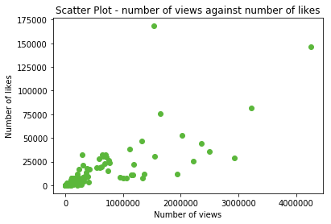
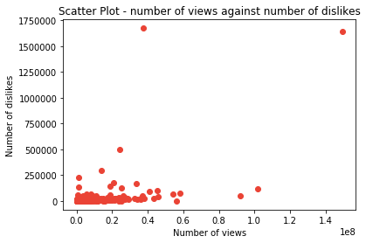
DATA VISUALIZATION
In the first scatterplot, there is a relation between number of likes and thr number of views, hence this data shows a positive correlation.
In the second scatterplot, there is no noticeable relation between number of dislikes and number of views , consequently there is no correlation at all .

Slide 10
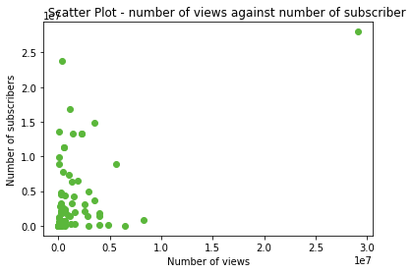
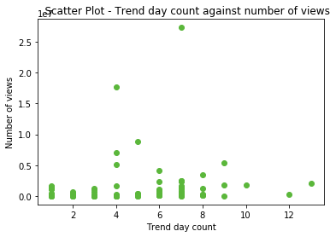
DATA VISUALIZATION
In the first scatter plot there is very low positive correlation between the number of views against the number of subscribers. This shows that subscriber count does not guarantee a large number of views.
In the second scatter plot there is no relation between the number of views and the number of days the video was trending for. This shows that YouTube does not consider the number of views only to classify a video as trending.

Slide 11
HYPOTHESIS TESTING
Designed a test to find if a video is viewed after a certain duration from date of publication.
Manipulated the data from two columns.
Date of Publication
Last Viewed Date
Computed the duration for each video and stored in ‘Duration’.
Mean duration is 107 days.
Standard deviation is 251 days.
A random sample of size 100 was drawn, with mean 135.

Slide 12
HYPOTHESIS TESTING
Null Hypothesis:
A video is not viewed after 105 days from date of publication.
H0 : μ <= 105
Alternate Hypothesis:
A video is viewed even after 105 days from date of publication.
H1 : μ > 105
Results:
For an alpha value of 5%
The null hypothesis was not rejected. Hence it is plausible that a given video is not viewed after 105 days from date of publication.

Slide 13


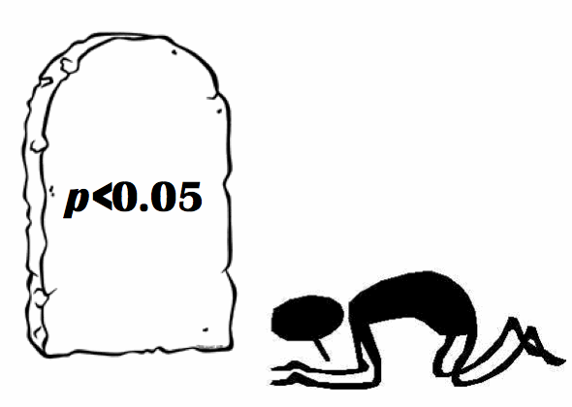

CONCLUSION
Dataset
Data Cleaning
Hypothesis Testing
Data Visualization

